Slide 1

Final Project Presentation: Balancing Prism
Siva Appana, Mannan Goel, Martha Leach, & Mesum Zaidi
ME 4012 Modeling and Control of Motion Systems
Fall 2023 Final Project Presentation

Slide 2
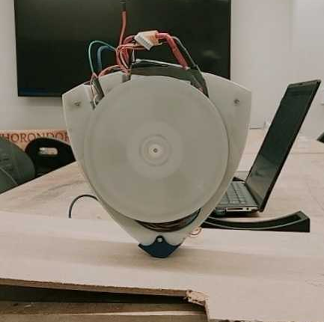
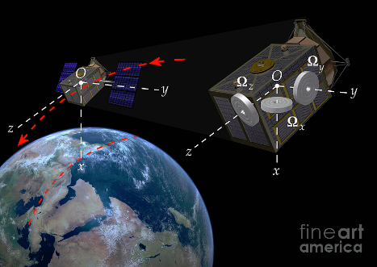
Motivation
Objective: Balance prism on its unstable edge using reaction torque
Applications:
Satellite attitude control [1]
Robot leg stabilization [2]
Skyscraper gyroscope design [3]
Control body’s angular position using flywheel’s reaction torque
Can be applied to any inverted pendulum problem
Notes:
Reaction wheels are a common method of stabilizing unstable dynamic systems by rotating a flywheel of a non-negligible moment of inertia at a variable angular velocity to manipulate angular momentum and reaction torque. They are used in situations like spacecraft and satellite stabilization as shown in Figure 1, where continuous disturbances to motion persist, with the reaction wheel inhibiting them and allowing for a degree of attitude control. Failure of these subsystems can result in an inability to adjust orientation as desired, which has occurred during the NASA Dawn and Kepler projects [1].
Fundamentally, the torque from the reaction wheel counteracts the torque due to imbalance forces to hold the system in a particular orientation, which is often unstable. Control techniques are necessary in this application to control the motor’s angular velocity, thus controlling the change in the flywheel’s angular momentum and, consequently, the torque. It requires rapid adjustments based on the disturbances and imbalances occurring, necessitating the quick response of a true control system.
Motivation: Quickly summarize your project. What are you trying to do? What are the applications? Why do you need control?
General Guidelines:
Choose one person to do the entire presentation. Remember to introduce all your teammates
Add at least one figure per slide, use as many figures as possible.
Keep font sizes large and use as few words as possible.
Your presentation should be 15 minutes long (including video) with 2 to 5 minutes for questions. This means you should have between 12 and 15 slides and spend about 1 minute per slide. You may add slides to this template where you need more room.

Slide 3
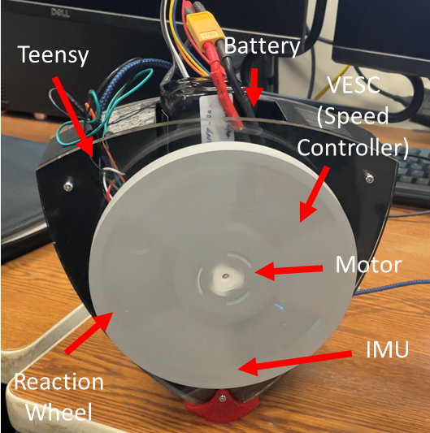
Design (Physical Assumptions)
Overall shape is Reuleaux triangle
Uses BLDC motor for increased torque and higher speed ceiling to avoid saturation
Assumptions:
Center of mass of wheel and main body are approx. at the same location
Sufficient friction at contact point to assume no slip
What Worked/Did Not Work:
Motor was incredibly powerful
Motor had dead zone in inputs
Original plastic flywheel lacked inertia
Original sharp edge was too unstable
Notes:
Include pictures of your design (sketches, schematics, CAD, photographs, etc..).
Label your pictures and describe verbally what your system does.
Describe any important design choices (why did you pick to use 2 motors instead of 1, etc.). What worked and what did not?

Slide 4
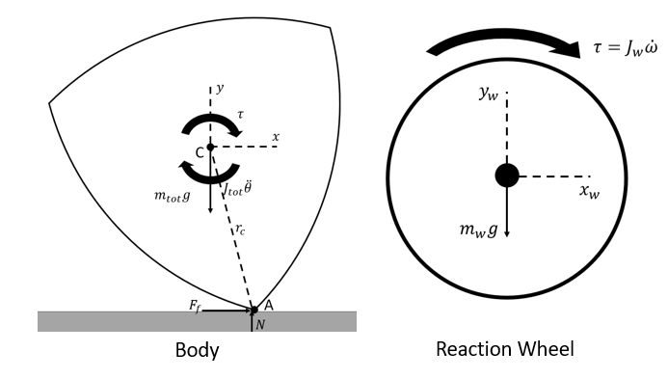
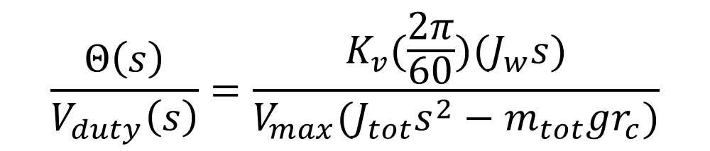
Model
Relates wheel velocity to body’s acceleration using angular momentum approach
Computed about contact point A
Used voltage-wheel velocity relationship to relate back to motor dynamics
Used simplified brushless DC motor model
Voltage-Velocity Constant
$$\frac{Θ\left(s\right)}{V_{duty}\left(s\right)}=\frac{K_{v}(\frac{2π}{60})(J_{w}s)}{V_{max}(J_{tot}s^{2}−m_{tot}gr_{c})}$$
Plant
Notes:
Quickly describe your model with a free body diagram. Do not include your entire derivation, just the main results. For example, just show your final transfer function and quickly define each variable.
List the derived/estimated values of parameters in a table. Explain quickly how you got the parameters. For example, if your system includes a mass, you may have measured it using a scale. If your system includes damping, you may have fitted this from a step response. You may have also found parameters from Solidworks or from doing system identification (example in Lab 5). Provide a table illustrating the parameters that you have identified or assumptions you had made to get different parameters.
The details of the derivation should be placed in the Appendix A of this presentation.

Slide 5
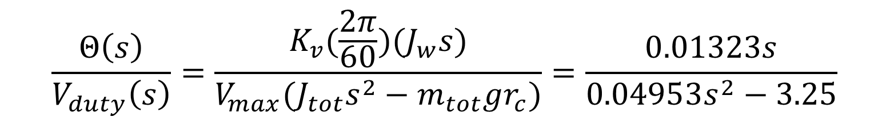
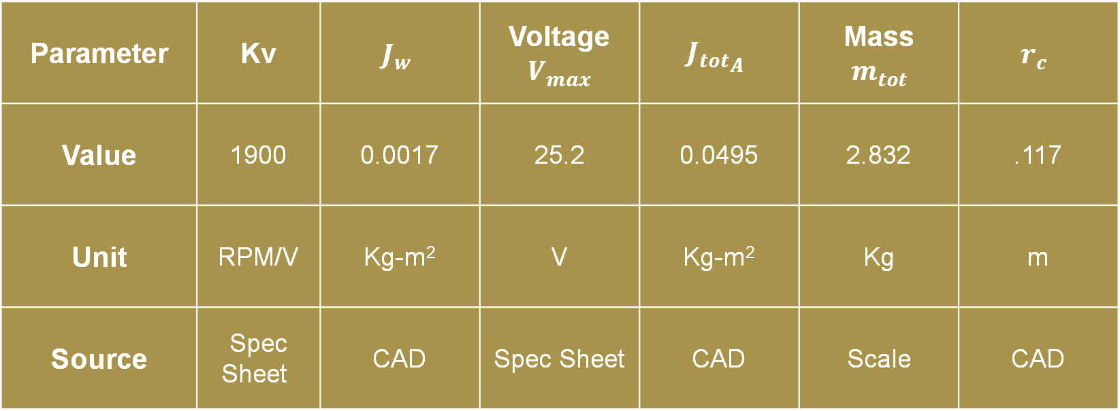
Model
Parameter | Kv | $$J_{w}$$ | Voltage$V_{max}$ | $${J_{tot}}_{A}$$ | Mass $$m_{tot}$$ | $$r_{c}$$
Value | 1900 | 0.0017 | 25.2 | 0.0495 | 2.832 | .117
Unit | RPM/V | Kg-m² | V | Kg-m² | Kg | m
Source | Spec Sheet | CAD | Spec Sheet | CAD | Scale | CAD
$$\frac{Θ\left(s\right)}{V_{duty}\left(s\right)}=\frac{K_{v}(\frac{2π}{60})(J_{w}s)}{V_{max}(J_{tot}s^{2}−m_{tot}gr_{c})}=\frac{0.01323s}{0.04953s^{2}−3.25}$$

Slide 6
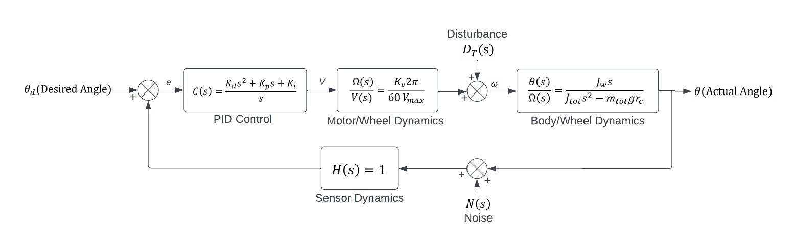
Controller Design – Block Diagram
Notes:
Draw a simple block diagram of your control system.
You can include root locus, bode, Nyquist, or state space design plots to show how you could design your controller. Show at least one of the methods discussed in class. PID tuning (as a design technique) is insufficient. If you did do PID tuning, show that you can stabilize your system using PID in theory using root locus, etc.
Describe any metrics you used for design like zero steady state error or fast response.

Slide 7
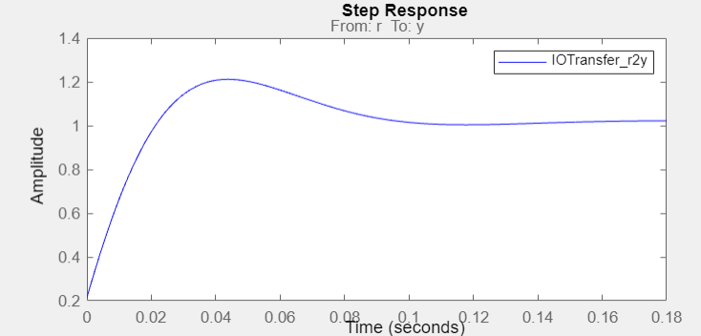
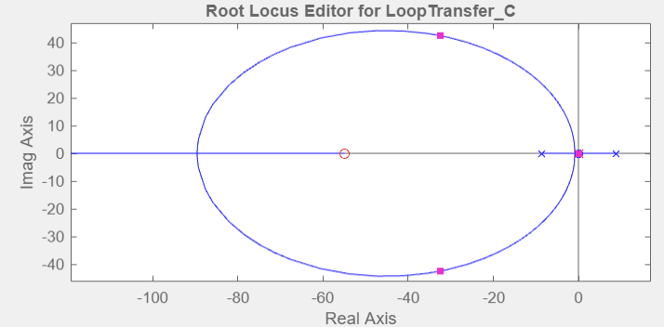
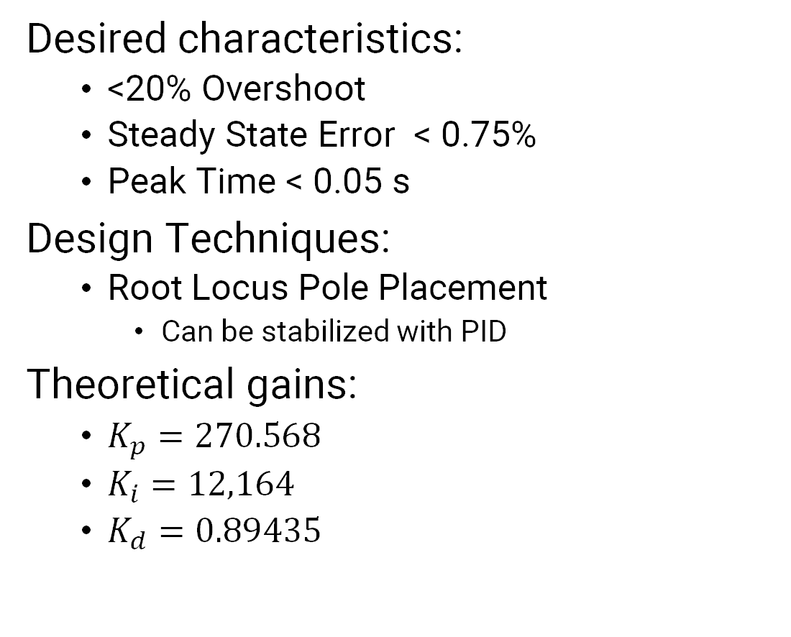
Controller Design – Results
Desired characteristics:
<20% Overshoot
Steady State Error < 0.75%
Peak Time < 0.05 s
Design Techniques:
Root Locus Pole Placement
Can be stabilized with PID
Theoretical gains:
$K_{p}=270.568$
$K_{i}=12,164$
$K_{d}=0.89435$

Slide 8
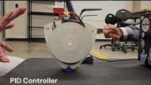
Video
Notes:
Include a video of your project operating here (experimental or simulation). A Video is Required.
For examples of well-formatted videos, go to http://pwp.gatech.edu/me4012/ and look at the class Youtube videos.

Slide 9
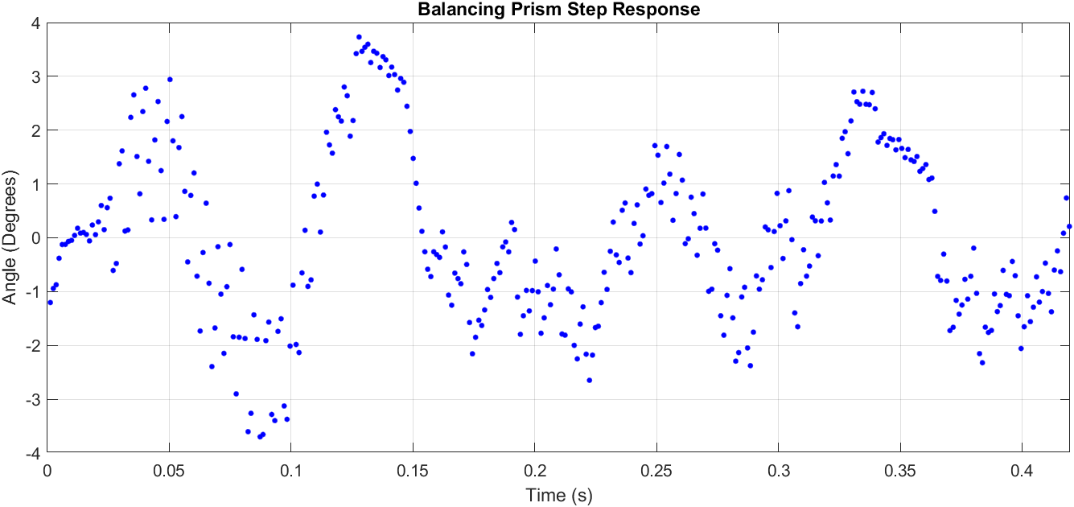
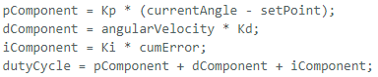
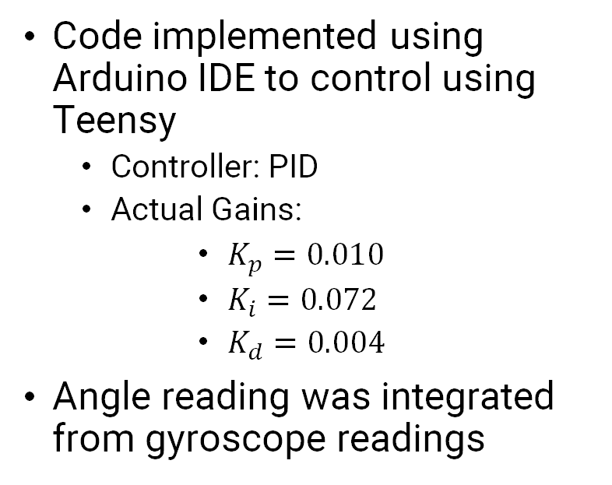
Experimental Results
Varied greatly from theory
Caused by:
Motor dead zone
Nonlinear motor behavior
Sensor drift
Imperfect weight balance
Slight amounts of slip
Oscillatory behavior even when controlled
Code implemented using Arduino IDE to control using Teensy
Controller: PID
Actual Gains:
$K_{p}=0.010$
$K_{i}=0.072$
$K_{d}=0.004$
Angle reading was integrated from gyroscope readings
Control Law
Notes:
Describe how you implemented your controller (Labview, Arduino, or Matlab Simulation). You can show a screenshot from your code or describe your the control law/state machine from your Arduino code.
Describe your final implementation and things you tried that worked or did not work.
If you took measurements, show your measured/simulation results (step responses, Bode plots, etc…).
If you did experiments or simulated a nonlinear model (and controlled a linear version): Compare your performance with expected performance from theory (you can do this by overlaying predicted performance plots with actual performance plots). Describe how your system matches or does not match with theory.

Slide 10
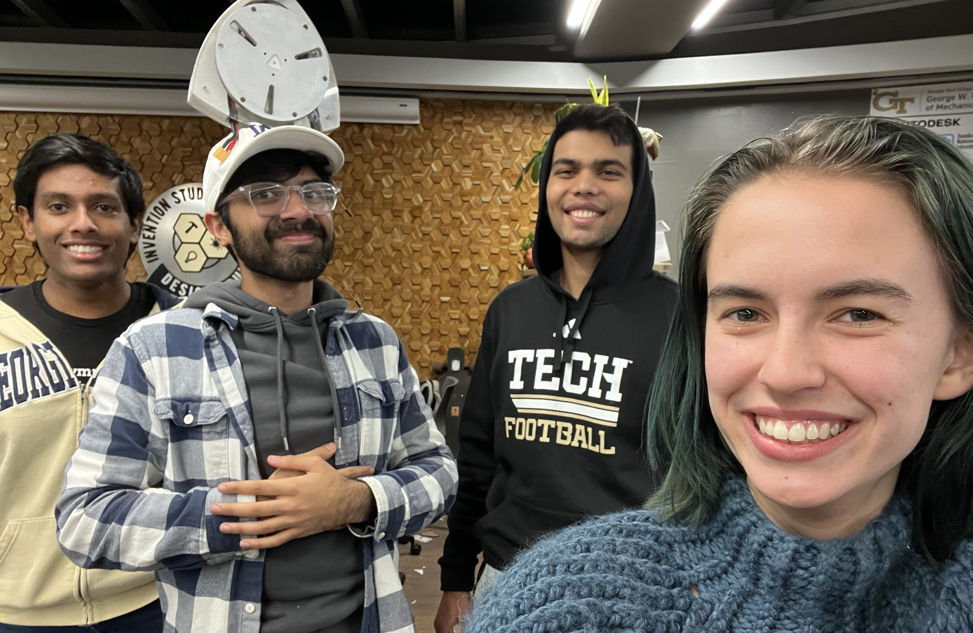
Conclusion
Successfully balanced the triangle
Stays vertical despite ~30 degree tilt from horizontal
Exhibited disturbance rejection
PID Control
Some discrepancies and nonlinearities between mathematical model and the actual model
Tuning controller corrected for issues
Potential improvements
Brushed motor for more accurate modeling
Move flywheel above triangle COM
the easier way to balance a triangle
Notes:
Summarize your project.
What are the main take-aways?
What worked and what didn’t work.
What would you do differently in the future?
Acknowledgements: (you can include your professor, TA, or others who helped you with your project)

Slide 11
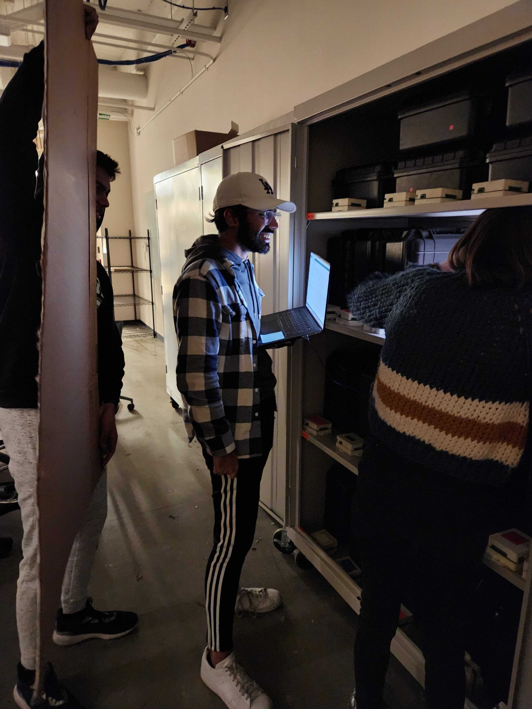
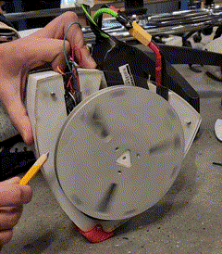
Special Thanks To
Dr. Mazumdar and Noah for all their help
Dr. Ferri for saying our first idea was horrifying to model
The pencil that we used to reset our Teensy and sharpened
The corpse of the combat robot we ripped the electronics from
The terrified faces of the onlookers in the Invention Studio when the motor went to 50% power
The 2110 trifold that Mannan used to shield the glow in the dark triangle from the light

Slide 12
References
[1] Bitar, Andreea "Understanding Reaction Wheels" https://aerospace.honeywell.com/us/en/about-us/blogs/understanding-reaction-wheels#:~:text=Reaction%20wheels%20are%20an%20integral,torque%2C%20like%20rockets%20or%20propellants.
[2] C. Lee, “Enhanced Balance for Legged Robots Using Reaction Wheels,” Robotic Exploration Lab. https://roboticexplorationlab.org/papers/reaction_wheel.pdf
[3] H. Higashiyama, M. Yamada, Y. Kazao, and M. Namiki, “Characteristics of active vibration control system using gyro-stabilizer,” Engineering Structures, https://www.sciencedirect.com/science/article/abs/pii/S014102969700076X#:~:text=The%20gyro%2Dstabilizer%2C%20which%20has,low%20levels%20of%20wind%20excitations. (accessed Nov. 29, 2023).
‌

Slide 13
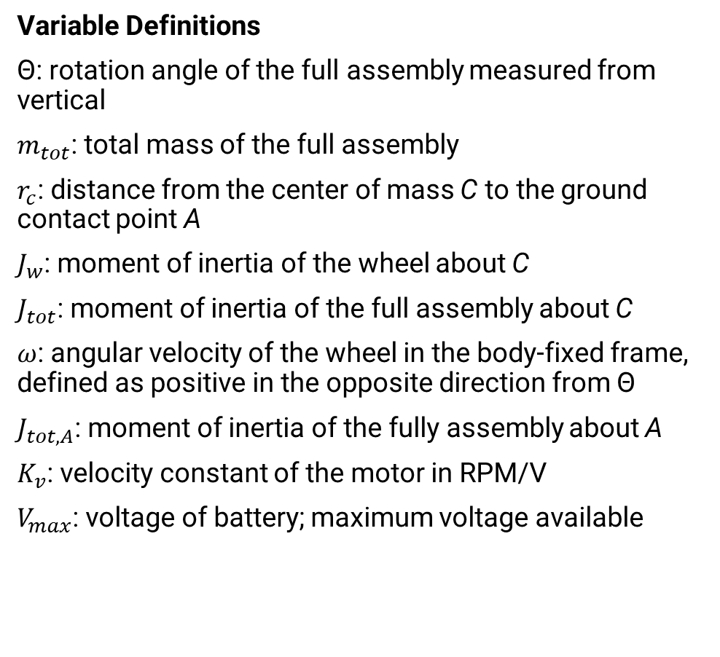
Appendix A: Model Derivation
Variable Definitions
$\text{Θ}$: rotation angle of the full assembly measured from vertical
$m_{tot}$: total mass of the full assembly
$r_{c}$: distance from the center of mass C to the ground contact point A
$J_{w}$: moment of inertia of the wheel about C
$J_{tot}$: moment of inertia of the full assembly about C
$ω$: angular velocity of the wheel in the body-fixed frame, defined as positive in the opposite direction from $\text{Θ}$
$J_{tot,A}$: moment of inertia of the fully assembly about A
$K_{v}$: velocity constant of the motor in RPM/V
$V_{max}$: voltage of battery; maximum voltage available

Slide 14
Appendix A: Model Derivation
Assumptions
There is sufficient friction to prevent slip at contact point A.
The centers of mass of the wheel and the main body are coincident with each other and with the motor shaft.
The dynamics can be linearized about θ = 0 such that sin(θ) ≈ θ and cos(θ) ≈ 1.

Slide 15
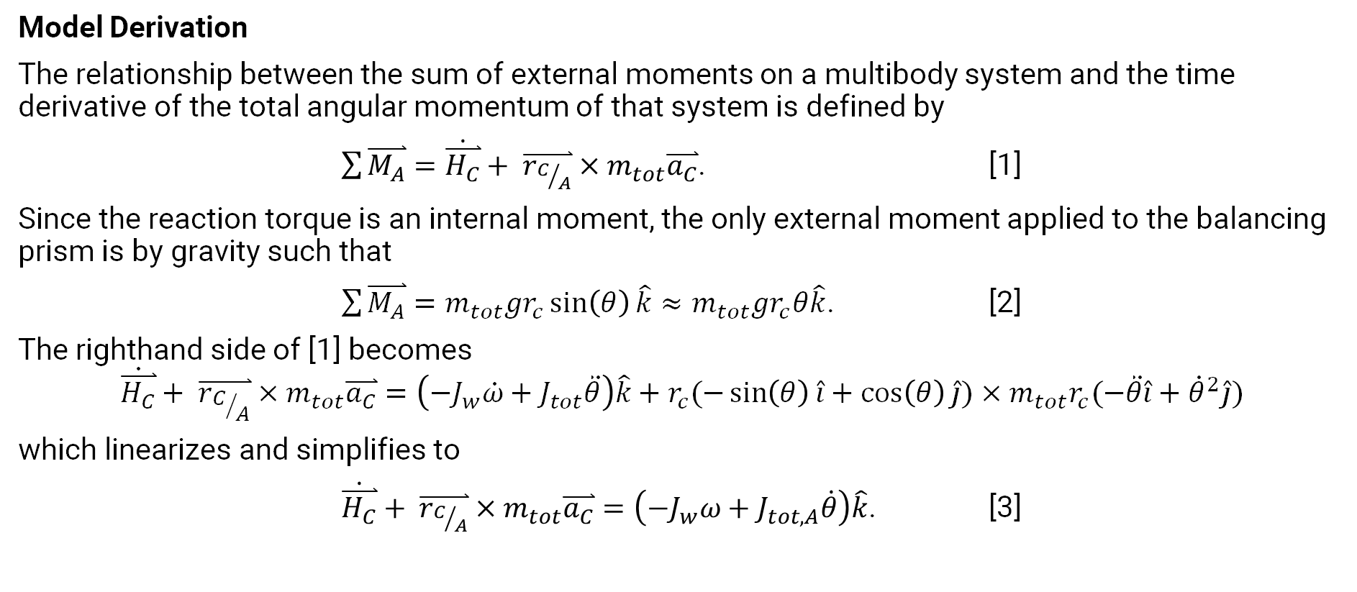
Appendix A: Model Derivation
Model Derivation
The relationship between the sum of external moments on a multibody system and the time derivative of the total angular momentum of that system is defined by
$\sum{\overset{⃑}{M_{A}}=\dot{\overset{⃑}{H_{C}}}+ \overset{⃑}{r_{C/A}}×m_{tot}\overset{⃑}{a_{C}}}$. [1]
Since the reaction torque is an internal moment, the only external moment applied to the balancing prism is by gravity such that
$\sum{\overset{⃑}{M_{A}}}=m_{tot}gr_{c}\sin\left(θ\right)\hat{k}≈m_{tot}gr_{c}θ\hat{k}$. [2]
The righthand side of [1] becomes
$$\dot{\overset{⃑}{H_{C}}}+ \overset{⃑}{r_{C/A}}×m_{tot}\overset{⃑}{a_{C}}=\left(−J_{w}\dot{ω}+J_{tot}\ddot{θ}\right)\hat{k}+r_{c}(−\sin\left(θ\right)\hat{i}+\cos\left(θ\right)\hat{j})×m_{tot}r_{c}(−\ddot{θ}\hat{i}+{\dot{θ}}^{2}\hat{j})$$
which linearizes and simplifies to
$\dot{\overset{⃑}{H_{C}}}+ \overset{⃑}{r_{C/A}}×m_{tot}\overset{⃑}{a_{C}}=\left(−J_{w}ω+J_{tot,A}\dot{θ}\right)\hat{k}$. [3]

Slide 16
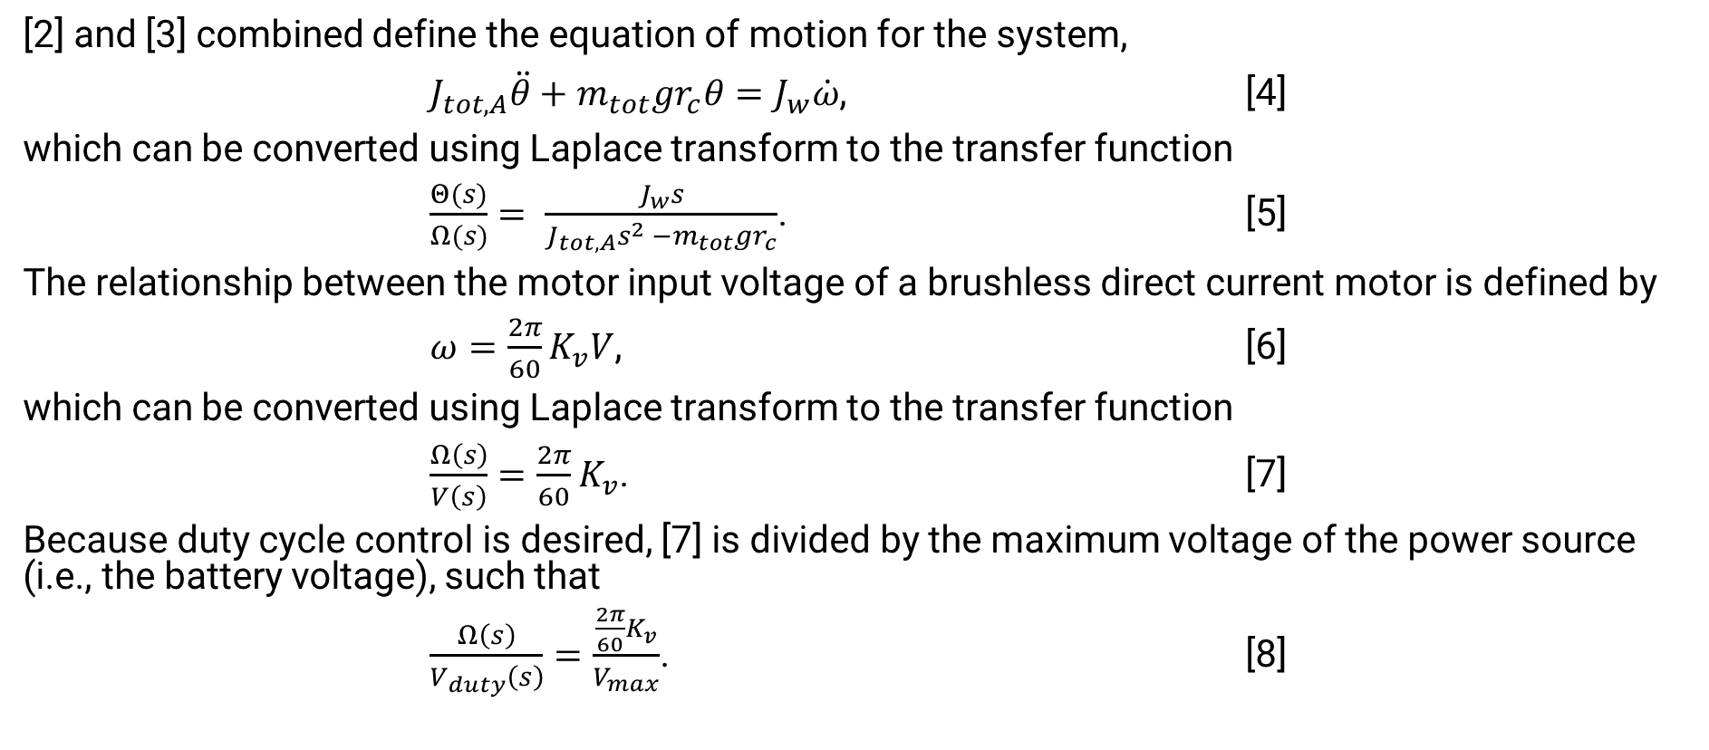
Appendix A: Model Derivation
[2] and [3] combined define the equation of motion for the system,
$J_{tot,A}\ddot{θ}+m_{tot}gr_{c}θ=J_{w}\dot{ω}$, [4]
which can be converted using Laplace transform to the transfer function
$\frac{Θ(s)}{Ω(s)}= \frac{J_{w}s}{J_{tot,A}s^{2} −m_{tot}gr_{c}}$. [5]
The relationship between the motor input voltage of a brushless direct current motor is defined by
$ω=\frac{2π}{60}K_{v}V$, [6]
which can be converted using Laplace transform to the transfer function
$\frac{Ω\left(s\right)}{V\left(s\right)}=\frac{2π}{60}K_{v}$. [7]
Because duty cycle control is desired, [7] is divided by the maximum voltage of the power source (i.e., the battery voltage), such that
$\frac{Ω\left(s\right)}{V_{duty}\left(s\right)}=\frac{\frac{2π}{60}K_{v}}{V_{max}}$. [8]

Slide 17
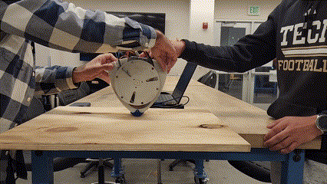
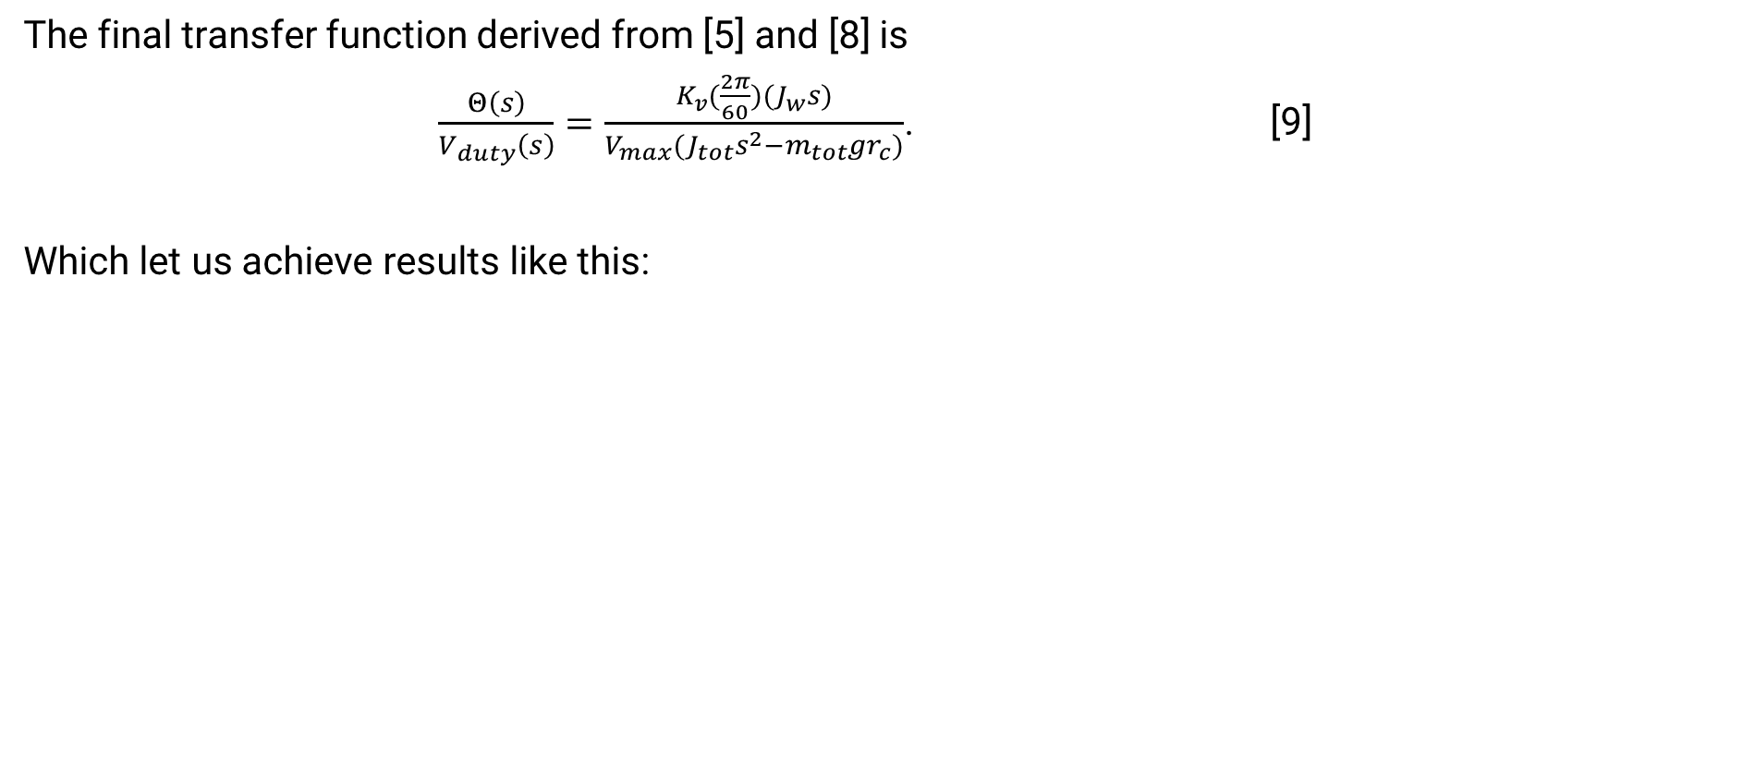
Appendix A: Model Derivation
The final transfer function derived from [5] and [8] is
$\frac{Θ\left(s\right)}{V_{duty}\left(s\right)}=\frac{K_{v}(\frac{2π}{60})(J_{w}s)}{V_{max}(J_{tot}s^{2}−m_{tot}gr_{c})}$. [9]
Which let us achieve results like this:

